Slide 1
ILLINOIS JUDICIAL BRANCH
PUBLIC RELATIONS PLAN
PRETRIAL IMPLEMENTATION TASK FORCE
DRAFTED BY THE ILLIONIS JUDICIAL CONFERENCE
PUBLIC RELATIONS TASK FORCE
Town Hall|Thursday, August 18
JUNE 2022

Slide 2
Please submit questions via the Zoom chat or email to pretrialtaskforce@illinoiscourts.gov.
Housekeeping
Please keep yourself muted to limit background noise. This session is being recorded and will be posted on the website.
In order to better address your questions, the Zoom chat is reserved for questions only—and priority will be given to those submitted in advance.
Due to time constraints, not all questions will be answered in today’s session.
But all questions will be recorded and used to inform future guidance from the Task Force.

Slide 3
Welcome
Introduction
Hon. Robbin Stuckert, Chair, Illinois Supreme Court Pretrial Implementation Task Force
Judge Stuckert is the Chair of the Illinois Supreme Court Pretrial Implementation Task Force after previously leading the Supreme Court Commission on Pretrial Practices. She served as a trial court judge for 20 years and retired from the bench in 2021.

Slide 4
History and Role
Pretrial Implementation Task Force
Constituted by the Illinois Supreme Court in 2020 to prioritize and implement recommendations from the Court’s Commission on Pretrial Practices—and help stakeholders prepare for the changes necessary to implement the law on January 1, 2023.
To accomplish this, the Task Force, its subcommittees, and other AOIC working groups are partnering with national, state, and local experts, including the Center for Effective Public Policy and Justice System Partners.

Slide 5
Providing Guidance
Pretrial Implementation Task Force
The Task Force is issuing guidance to assist with implementation of the Pretrial Fairness Act.
As is the case with any new law, some questions—particularly around statutory interpretation—will be decided by the courts, and the Task Force cannot weigh in on these issues.
Counties are encouraged to meet with local criminal justice system partners to determine what changes are needed to current local practices to comply with the new law.
Any guidance provided by the Task Force is just that. It is not an official position of the Illinois Supreme Court.

Slide 6
Monthly Town Hall Series
Purpose:
Disseminate information and guidance around key components of the PFA.
Provide a forum for questions about implementation of the law.
However, the Task Force and its subcommittees are not advocates for or against the PFA—they simply provide guidance to help counties prepare for implementation of the law.

Slide 7
Monthly Town Hall Series
Topics:
June 2022: Introduction to the PFA
July 2022: Release by citation and release from custody
August 2022: Pre-first appearance process and activities
Upcoming topics include:
Conditions of release
Pretrial assessment
Revocation / modification of conditions of release
Detention hearings
Town halls will continue throughout 2022 and into 2023

Slide 8
Topic for Today’s Town Hall
Pre-First Appearance Activities
Presenters:
Keith Grant, President, IL Public Defender Association; Senior Supervisor, Lake County Public Defender’s Office
Nathan Rowland, Hamilton & Gallatin County Public Defender
John Carroll, Deputy Chief of Staff, Office of the Illinois Attorney General
Cara Smith, Director, IL Office of Statewide Pretrial Services

Slide 9
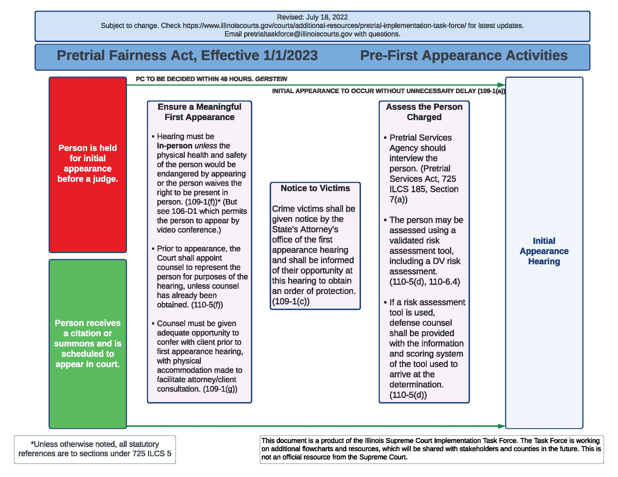
Pre-First Appearance Activities: Flowchart
Notes:
Click to show map

Slide 10
Ensuring a Meaningful First Appearance
In-person hearings: “At the hearing at which conditions of pretrial release are determined, the person charged shall be present in person rather than by video phone or any other form of electronic communication, unless the physical health and safety of the person would be endangered by appearing in court or the accused waives the right to be present in person.” 725 ILCS 5/109-1(f).
Interpretation considerations: This section is inconsistent with 725 ILCS 5/106D-1, which allows video conferences for first appearances when a person is in custody.

Slide 11
Ensuring a Meaningful First Appearance
In-person hearings
Operational considerations:
Conducting in-person first appearance hearings where defense counsel must be present may be a hardship for many counties, where public defenders cover multiple counties and courthouses are several hours away from each other.
Note that the person accused always has the option to waive an in-person hearing.
Video conference is not permitted for a hearing in which pretrial release will be denied.
In small counties, they must address the circumstances of transporting the charged person to court if the Sheriff is the only person on duty and the person charged is held in a different county.

Slide 12
Ensuring a Meaningful First Appearance
Representation
“Prior to the defendant's first appearance, the Court shall appoint the public defender or a licensed attorney at law of this State to represent the Defendant for purposes of that hearing, unless the defendant has obtained licensed counsel for themselves.” 725 ILCS 5/110-5(f).
“Defense counsel shall be given adequate opportunity to confer with the defendant prior to any hearing in which conditions of release or the detention of the defendant is to be considered, with a physical accommodation made to facilitate attorney/client consultation.” 725 ILCS 5/109-1(g).

Slide 13
Ensuring a Meaningful First Appearance
Representation
Operational considerations:
Chief Judges may wish to consider issuing a standing order to appoint the Public Defender or other counsel for all first appearances.
Defense counsel and corrections need to collaborate to find space for private/confidential conversations to take place between counsel and the charged person.
Note that Covid protocols could make it difficult for defense counsel to meet in-person with their client.
Corrections and public defender/defense counsel should collaborate to decide if meeting with a client must be in person or not.

Slide 14
Ensuring a Meaningful First Appearance
Notice to Victims
“The court may issue an order of protection in accordance with the provisions of Article 112A of this Code. Crime victims shall be given notice by the State’s Attorney’s office of this [initial] hearing as required in paragraph (2) of subsection (b) of the Rights of Crime Victims and Witnesses Act and shall be informed of their opportunity at this hearing to obtain an order of protection under Article 112A of this Code.” 725 ILCS 5/109-1(c).

Slide 15
Ensuring a Meaningful First Appearance
Notice to Victims
Interpretation considerations:
This section requires the notification to crime victims of the initial hearing.
There is no paragraph 2 of subsection (b) of the Rights of Crime Victims and Witnesses Act
The responsibility for victim notification pursuant to that subsection of the RCVWA 725 ILCS 120(b) is with “any law enforcement agency that investigates an offense,” and not with State’s Attorneys.
The definition of “Court Proceeding” under the RCVWA specifically excludes victim notice by State’s Attorneys for initial appearances under Section 109-1.

Slide 16
Ensuring a Meaningful First Appearance
Notice to Victims
Operational considerations:
State’s Attorney’s offices should have a policy and process (and a form) to provide notice to crime victims, sufficient time in advance of the scheduled date and provide an opportunity to seek orders of protection at the initial appearance.
If court hearings will be held on the weekend, victim assistance groups must be notified to ensure assistance is available to victims as needed.

Slide 17
Ensuring a Meaningful First Appearance
Assessment of the Person Charged
Pretrial Services should interview the person.
The person may be assessed using a validated assessment tool, including a DV assessment.
If an assessment tool is used, defense counsel shall be provided with the information and scoring system of the tool.

Slide 18
The Task Force will publish the work of the Guidelines Subcommittee on an ongoing basis ahead of the Jan. 1 effective date. Upcoming Town Hall topics include:
Reminder: Guidance & Town Halls
Conditions of release
Pretrial assessment
Modification of conditions/Revocation
Detention hearings
Notes:
Click to show map

Slide 19
Upcoming Town Halls
September 15, Noon
October 20, Noon
November 17, Noon
All meetings will be held via Zoom unless otherwise noted.

Slide 20
Questions?
Website: www.illinoiscourts.gov/courts/additional-resources/pretrial-implementation-task-force/
Email: pretrialtaskforce@illinoiscourts.gov

